Slide 1
RoboDoc: EEG and IMU
Daniel Mata, Steve R Parker, and Mohammad Khamis

Slide 2
IMU Project Description and Objectives
Build a portable tremor recorder for Parkinson’s patients to diagnose disease progression.
Use IMUs for diagnosis of Parkinson disease by measuring tremor in patients.
The readings will be recorded by a microcontroller with wireless capability.
The reading from the IMU will then be categorized into a Tremor Score that corresponds to the UPDRS of 0-4
Filter out non-parkinsonian tremors outside range of 3.5-7.5 Hz
Write algorithm to quantify the severity of parkinsonian tremor

Slide 3
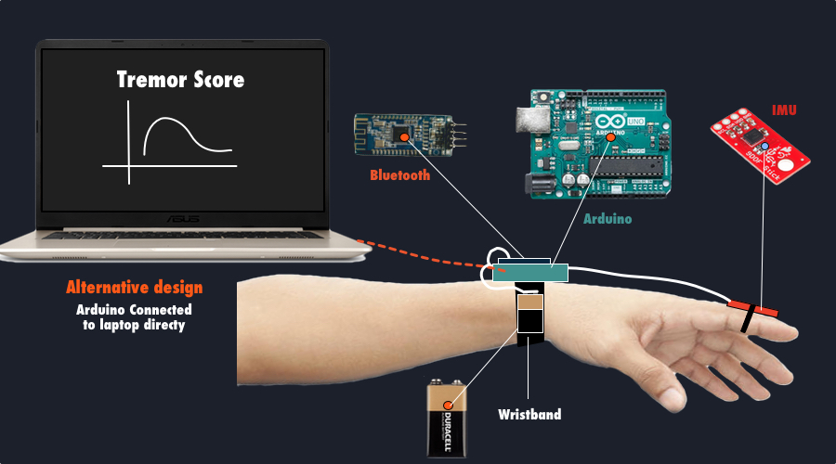
Parkinsonian Tremor Detector Design

Slide 4
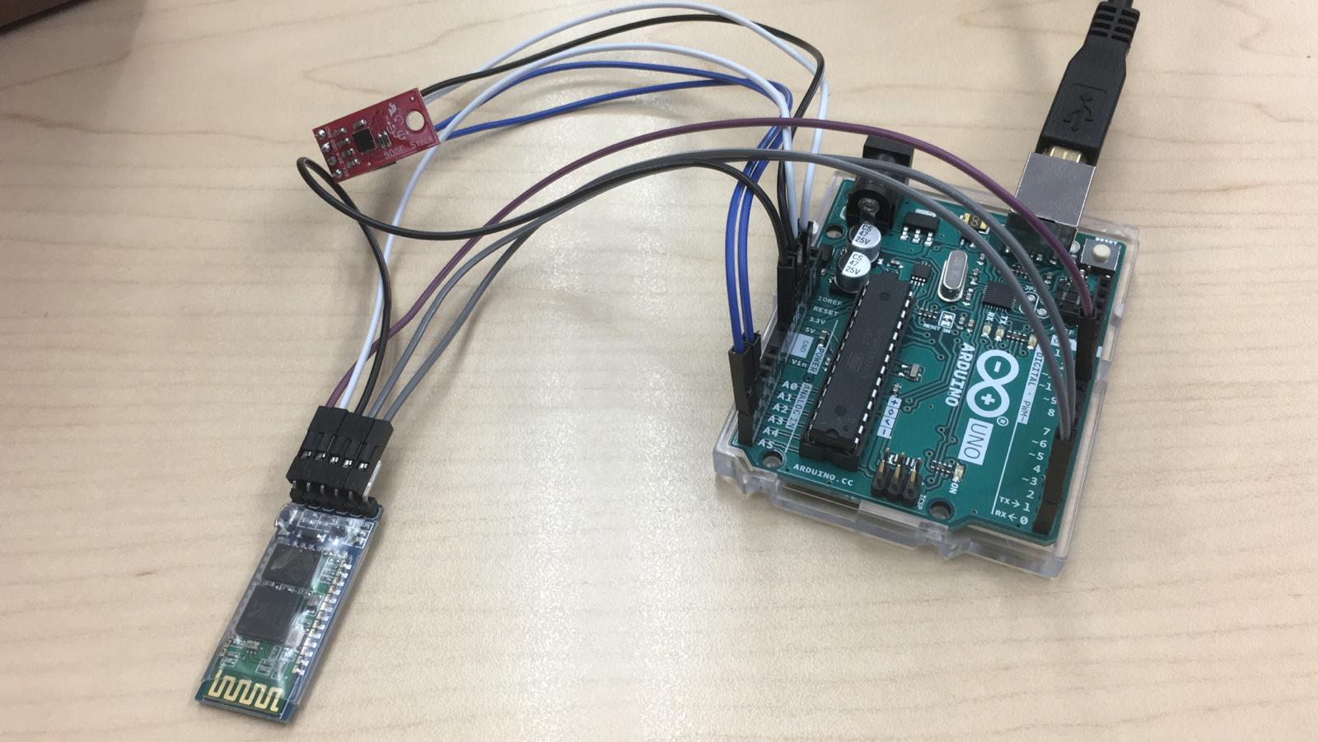
Hardware Update

Slide 5
Arduino Code
Downloaded the LSM9DS1 Arduino Library online.
Combined it with the bluetooth code
Still working on it

Slide 6
EEG Project Description and Objectives
Monitor and record a subject’s attention and stress level
Establish ability to read useful data.
Filter unwanted noise.
Matlab - Neural Network AI
Design simple and effective psych intake in the GUI

Slide 7
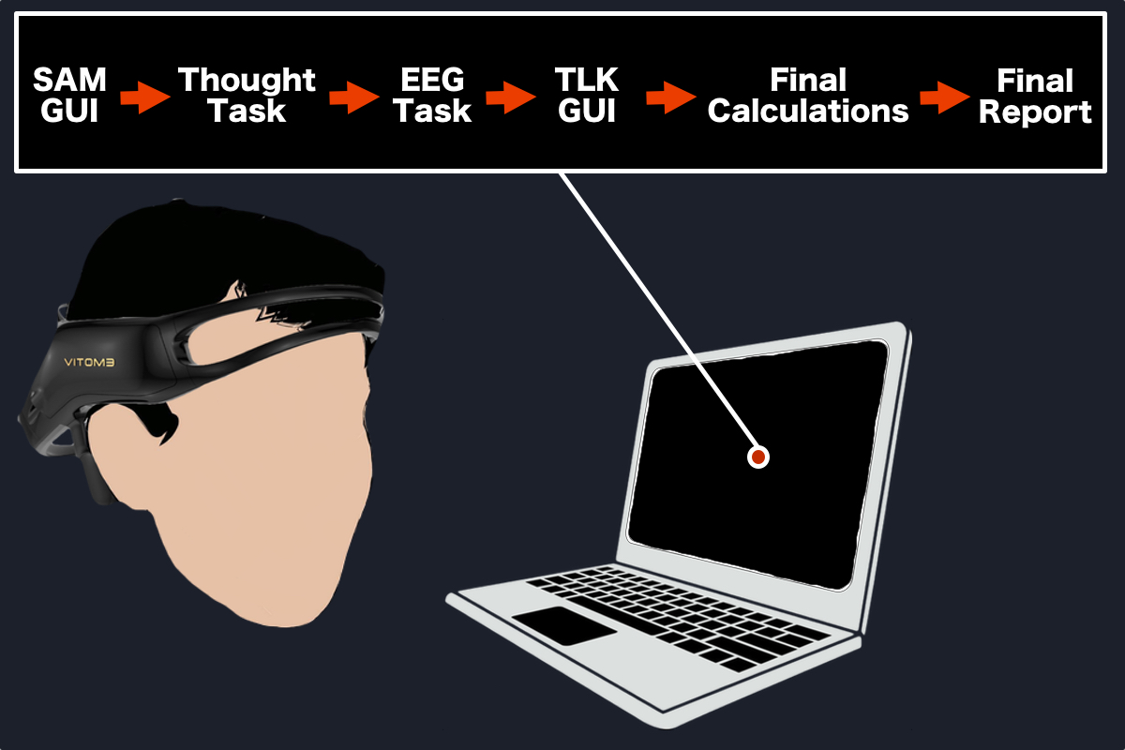
EEG Mood/Stress Evaluator Design

Slide 8
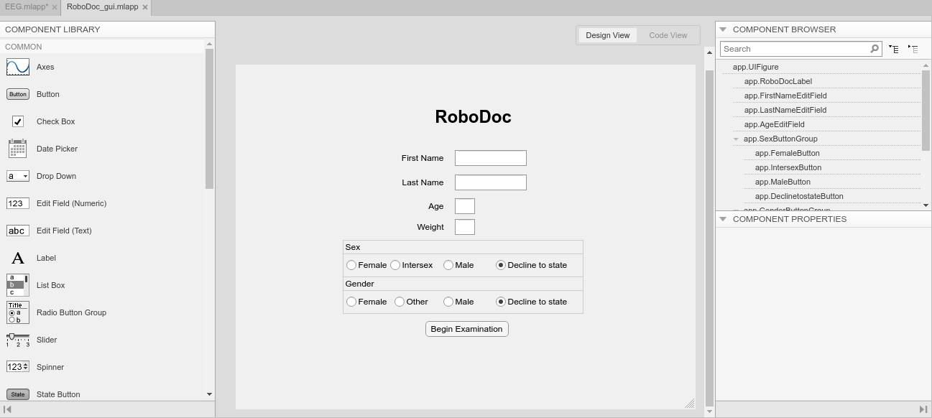
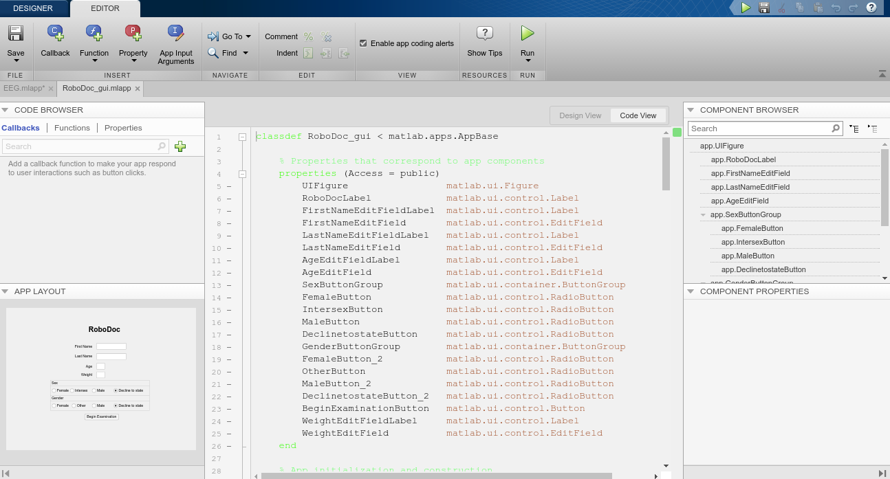
Matlab App Designer

Slide 9
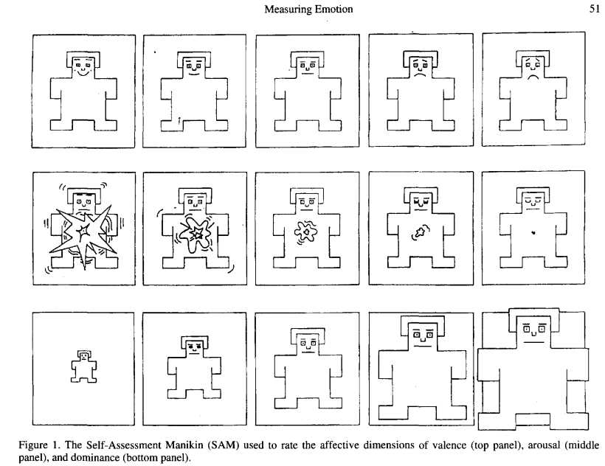
SAM

Slide 10
Plans For Next 2 Months
Finish programing Arduino to read IMU data
Creating a Matlab script to import and analyse the collected IMU data
Complete Parkinsonian Tremor Detector design and assembly
Find ways to test our tremor detector
Finish RoboDoc GUI on Matlab for the Parkinsonian Tremor Detector and EEG Mood/Stress Evaluator
Fine tune SAM and TLX surveys with mentor feedback.
Review EEG options with EEG mentor.
Purchase and set up EEG.

Slide 11
Future Difficulties/Challenges
Unable to purchase/order Emotiv in time to finish project
Ordering a less expensive EEG with less channels, which makes it more difficult to collect enough data to complete project description
IMU Arduino Library is not working.

